Slide 1
QUALITATIVE ANALYSIS OF ORGANIC COMPOUND
This involves method of identifying elements and functional groups present in unknown organic compound. Organic compounds are assumed to contain carbon, hydrogen with other elements such as oxygen, Nitrogen, Sulphur, Halogens and phosphorous. These elements except carbon and Hydrogen which are assumed to be present in organic compounds can be detected by SODIUM FUSSION TEST (LASSAIGNE’S TEST).

Slide 2
SODIUM FUSSION TEST (LASSAIGNE’S TEST)
Experimental procedure:
50 mg of solid or 2 drop of liquid is added to sodium in an ignition tube and heat gently at first and then more strongly to red heat. The filtrate (known as sodium fusion filtrate)
This test converts any Nitrogen, Sulphur, Phosporous, Halogen present in an organic compound into sodium cyanide, sodium sulphide, sodium phosphide and sodium halide respectively according to the following equation.
(C, H, N, S, P, X) + Na_{(s)} Na CN + Na₂S + Na₂P + NaX
Excess (x = f, Cl Br, I)

Slide 3
TEST FOR NITROGEN
To 4 cm³ of the sodium filtrate, 0.5 cm³ of cold saturated solution of FeS0₄ (Iron Sulphate) was added. The mixture was then boiled for 30 min. FeCl₃ was added and then acidified by adding concentrated HCl or 3 M H₂S0₄ drop wise. The formation of PRUSSIAN BLUE (bluish-green) precipitate.I ndicates the presence of Nitrogen.
6 NaCN + Fe S0₄ $→$ Na₂S0₄ + Na₄Fe (CN)₆ 4FeCl₃ + 3Na₄Fe(CN)₆ $→$ 12NaCl + Fe₄ [Fe (CN)₆]₃
TEST FOR SULPHUR
Take 2.5 cm³ of the sodium fusion filtrate add a few drop of lead ethanoate solution and acidified with dilute ethanoic acid. The formation of a black precipitate of lead (II) sulphide indicates the presence of sulphur
Na₂S + Pb(C00CH₃)₂ PbS + 2CH₃COONa
Black precipitate
CH₃COOH

Slide 4
TEST FOR HALOGENS
The test for nitrogen and sulphur are positive, boil the sodium fussion filtrate for some minute to expel hydrogen cyanide and hydrogen sulphide which might interfere with the test for halogen. The presence of halogen is tested by acidifying a portion of the sodium fusion filtrate with dilute HNO₃ and adding silver nitrate (Ag NO₃). The formation of a precipitate indicates the presence of halogen
Na X +Ag NO₃ Ag X + Na NO₃
The solubility of the precipitate is then tested in aqueous ammonia to identify the specific halogen present.
precipitate would be WHITE and readily soluble in aqueous ammonia if chlorine
the precipitate would be FADE YELLOW and slightly less soluble in aqueous ammonia if bromine
the precipitate would be YELLOW and insoluble in aqueous ammonia if iodine

Slide 5
TEST FOR PHOSPOROUS
To 1 cm₃ of the sodium fussion filtrate, add about 2 cm³ of concentrated HNO₃ and boil in order to convert any phosphorous present into phosphate (v) ion, cool the solution and add ammonia molybdate (vi). The formation of a YELLOW precipitate gently warning to a temperature of 50 ⁰C indicates the presence of phosphorous.

Slide 6
ISOLATION AND PURIFICATION OF ORGANIC COMPOUND
The techniques for isolation and purification of organic compounds use phase equilibra.
ISOLATION BY EXTRACTION
Solid – Liquid extraction
When the material to be extracted into a liquid is very soluble, simple stirring or shaking of a suspension of a solid in the liquid followed by gravity filtration to move insoluble impunities (cold extraction).
When the material to be extracted is less soluble or is appeal in an insoluble matrix, a continuous extraction device such as soxhlet extractor used. This device boils the extracted liquid, condense it so that it can come in contact with solid. The liquid is then siphons back into the boiling flask.

Slide 7
Liquid – liquid Extraction.
This method is used to separate a component from one liquid phase into another. In most cases, one phase as in aqueous soluble and the other is an immiscible organic liquid. Two phases are shaken together gently in a separatory funnel. It is then separated by allowing the lower dense phase to drain out. Multiple extraction can be done.
PURIFICATION
The purification of organic compounds is a necessary step after its extraction from a natural source or its synthesis in the laboratory. The methods depend on the nature of the compound and the impurity present.
The factors that could be considered when selecting method of purification are Boiling point, melting point, solubility and cyristallization.

Slide 8
METHOD OF PURIFICATION
Sublimation: It can be applied to only compounds that change their state directly from solid to vapour on heating. Hence, it can be used to separate sublimable compound from non-sublimable impurities.
Crystallization: This method uses the differences in solubility. When a concentrated solution is prepared by dissolving a compound in a suitable solvent the pure compound crystallizes out on cooling. The dissolved impurities are removed through filtrations. Example is the mixture of sugar and sodium chloride NaCl in hot ethanol (C₅H₅OH).
Distillation: It is used in the separation of liquid with sufficient differences in their boiling point.

Slide 9
4. Fractional Distillation: It is the separation of mixture used on the boiling point when the mixture is heated. The fractions or component with the lower boiling point vapourizes followed by the components with the higher boiling point.
5. Steam distillation: In this method substances which are steam volatile and immiscible with water can be separated basically lowering the distillation of the organic compound which is immiscible with water.
6. Differential extraction: This is similar to the solid-liquid extraction as well as the liquid-liquid extraction discussed earlier.
7. Chromatography: It is an important techniques used to separate constituent particles of a mixture of a substance. It can also be used to purify.

Slide 10
Principle of chromatography is based on the differences in the rate at which the component of a mixture moves there through a porous medium called stationary phase under the influence of some solvent or gas called mobile phase. This technique consists of two phases;
Stationary phase of large surface area
Mobile phase which is allowed to move slowly over the stationary phase.
The stationary phase is either a solid or a liquid while the mobile phase may be a liquid or a gas.

Slide 11
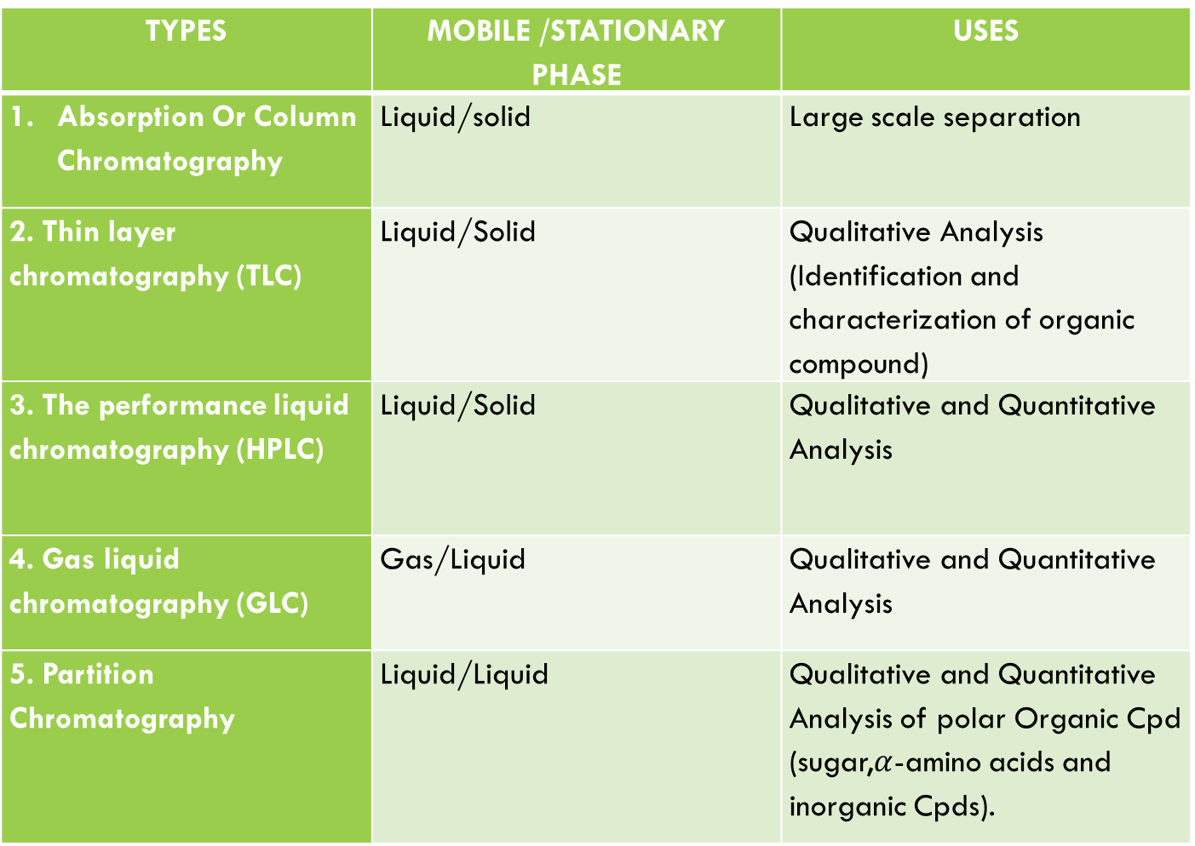
TYPES OF CHROMATOGRAPHY
TYPES | MOBILE /STATIONARY PHASE | USES
Absorption Or Column Chromatography | Liquid/solid | Large scale separation
2. Thin layer chromatography (TLC) | Liquid/Solid | Qualitative Analysis (Identification and characterization of organic compound)
3. The performance liquid chromatography (HPLC) | Liquid/Solid | Qualitative and Quantitative Analysis
4. Gas liquid chromatography (GLC) | Gas/Liquid | Qualitative and Quantitative Analysis
5. Partition Chromatography | Liquid/Liquid | Qualitative and Quantitative Analysis of polar Organic Cpd (sugar,$α$-amino acids and inorganic Cpds).

